Slide 1



Crowdsourcing Metadata
Reliably Augmenting Documents By Collecting and Interpreting Amateur Contributions
Peter Organisciak
September 22, 2015
1
Notes:
Good morning.
Thank you for coming.
Particularly, I’d like to thanks my committee: Mike, Miles, Jaime, and Stephen for their time.

Slide 2


Maximizing data quality
in using paid crowds for objective and
subjective encoding tasks
Notes:
So, let’s return to that problem statement.

Slide 3
INTRODUCTION
Crowdsourcing



Commons-Based Peer Production

Human Computation
Free/Open Source
Human work organized in the manner and tropes of computation
Creation from the commons, stemming from increased agency in networked information economy.
Crowdsourcing
A principle of software source code openness that evolved into a model of hyper-collaboration, often without discrimination toward the contributor, and quick user-focused development.
Broadly describes the use of distributed crowds to complete a task that would otherwise be done by one or a few people.
Captures the ability of the Internet toefficiently connect people


User Innovation
Wisdom of the Crowds
Shifting focus on creation by a product’s users.
observes the collected effectiveness of crowds when properly aggregated
von Hippel 1988
Raymond 1999
von Ahn 2004
Surowiecki 2004
Benkler 2006
Howe 2006
3
Notes:
Crowdsourcing refers to the action of outsourcing a task that might traditionally be done by a single person to a large, often self-selected group of people.
It was coined in an article of Wired in 2006. However, the idea of many amateurs collaborating directly or indirectly on the same product is not new, and different facets of crowdsourcing were previously studied.
<slide>
In 2006, Yokai Benkler wrote Wealth of Networks, a critical work trying to understand networked information society. There, he noted the ability of the Internet to empower people to create information goods for each other in the commons, rather than receiving them from firms.
Eric von Hippel has been making a similar argument for decades, around technology’s recontextualization on users.
In 2004, pop science book Wisdom of the Crowds popularized interest in the collective intelligences of crowds, when they are well connected.
That same year, the concept of Human Computation was beginning to gain traction. If the wisdom of the crowds refers to the unique abilities of human intelligence in aggregate, human computation focuses on human abilities as distinct from computational methods -- for so long as they are distinct -- and aims to formalize methods to organize humans in manners akin to automation.
Of course, the vanguard of how well people can collaborate through the aid of networked technology is the free software movement, with started by sharing source code for software but experienced a sea change with the hyper-collaborative Linux project in the early 90s.

Slide 4
INTRODUCTION
Information Science
Image Tagging
Content Recommendation
Describing images in different language.
e.g. steve.museum, The Commons
Judging information quality, reviewing/filtering, user-curated lists.
e.g. Bibliocommons


Relevance Judgments (IR Evaluation)

Generate custom evaluation datasets over novel corpora.


−
Transcription
e.g. Transcribe Bentham, Trove, What’s on the Menu
Research
Other Encoding
Galaxy Zoo, Snapshot Serengeti
4

Slide 5
INTRODUCTION
Types of Crowdsourcing
Paid
Creative
Volunteer
Reactive
Reactions to existing information objects
Subjective
A ‘good’ contribution depends on context
Objective
Working toward a universal or agreeable ‘truth’
5
 More in chapter: Design Facets of Crowdsourcing: A Typology for Information Science

Slide 6
Online crowds are useful because they’re quick, accessible at large-scales, but also
Perceptive
Clever
Critical
Notes:
This is a boon for certain types of research, but also introduces issues due the subjectivity inherent to certain

Slide 7
Why does this matter?
Digitized and born-digital information is outpacing our ability to clean, annotate, organize it. Crowdsourcing is being used to address these problems
In information retrieval,
Custom evaluation datasets (research over novel datasets!) – e.g. Alonso 2008
Understanding unseen queries (e.g. Chen and Jain 2013)
Adding additional metadata to documents implicitly (e.g. Lamere 2008) or on-demand (e.g. Finin et al 2010)

Slide 8
Why does this matter?
Crowdsourcing is the path toward qualitative big data
Notes:
As a digital humanist I’m well aware of the discord between qualitative close reading and large-scale quantified research. These activities that people are so good at -- description, judgment, criticism, interpretation – these often fall by the wayside as we work with bigger datasets, bigger collections. Crowdsourcing helps us bring it back.

Slide 9

❑
However, humans have predictable and unpredictable biases that make it difficult to systematically adopt their contributions in an information system.
Notes:
Today, I’m presenting my dissertation research pertaining to data quality issues in crowdsourcing.
How do you interpret and collect contributions from paid online crowds reliably?
Before I delve too deep into what exactly that means, it’s important to understand some of the background around what is known as crowdsourcing and how it pertains to us.

Slide 11

Maximizing data quality
in using paid crowds for objective and
subjective encoding tasks
Notes:
So, let’s return to that problem statement.

Slide 13
INTRODUCTION
Typical Task



13

Slide 14
INTRODUCTION
This study’s focus









14

Slide 15
INTRODUCTION
Research Questions
Broad Research Question #1
Broad Research Question #2
Broad Research Question #3



What are the post-collection indicators of quality in worker-contributed objective task data, and can these be leveraged for improved data modelling?
What are the biases inherent to the task design for objective or normative tasks (i.e. the data collection instrument), and can design manipulations correct for them at collection time?
What are the quality losses when treating non-normative tasks in objective ways, and can collection-time framing or post-collection modeling approaches reduce these?
15

Slide 16
INTRODUCTION
Scope
Paid
Creative
Volunteer
Reactive
Reactions to existing information objects
Subjective
A ‘good’ contribution depends on context
Objective
Working toward a universal or agreeable ‘truth’
16

Slide 17
Broad Research Question #1
Broad Research Question #2
Broad Research Question #3



What are the post-collection indicators of quality in worker-contributed objective task data, and can these be leveraged for improved data modelling?
What are the biases inherent to the task design for objective or normative tasks (i.e. the data collection instrument), and can design manipulations correct for them at collection time?
What are the quality losses when treating non-normative tasks in objective ways, and can collection-time framing or post-collection modeling approaches reduce these?
Work completed with Miles Efron, Katrina Fenlon, and Megan Senseney
17

Slide 18
How can you determine if a contribution by a self-selected amateur is reliable?

Slide 19
INTERPRETING OBJECTIVE TASKS FOR PAID CROWDSOURCING
DATA
Primary Dataset: IR Relevance Judgments


Comparison Dataset: Twitter Sentiment Judgments
23000 relevance judgments produced by self-selected, semi-anonymous workers.
Collected through paid platform Amazon Mechanical Turk, judging retrieval over variable length documents in cultural heritage collection.
Sentiment ratings for a series of tweets also generated on Mechanical Turk.

5 contribution options
Granularity

3 contribution options
Granularity
19
Notes:
- With Information retrieval relevance judgments, you export a series of possible results for a query, then people judge how strong those results are.

Slide 20
INTERPRETING OBJECTIVE TASKS FOR PAID CROWDSOURCING
Questions
Experience
Do raters grow more reliable over time?
Can you account for the rating distribution given the rater's experience?
Agreement
. Does a rater's agreement or disagreement with other raters reflect their overall quality as a rater? We also investigated ways to quantify disagreement and to correct for it.
Temporality
Does the length of time that a rater spends on a question reflect the quality of their rating?
20

Slide 21
Distribution of raters' agreement with other raters (x) and agreement with oracle ratings (y).
Notes:
Since agreement with oracle ratings tends to be higher than agreement with other raters, judging the quality of a rater by the latter measure is a conservative approach. Note that oracle ratings are available for only a subset of the data, and only raters with a minimum of ten ratings overlapping with the oracle set are included in this graph.
Coles notes: evaluating with agreement with other users as a proxy for agreement with the oracle ratings is a good, but more conservative proxy.

Slide 22
Number of ratings contributed per rater, roughly following a power-law distribution

Slide 23
Temporality
Dwell Time: Time spent on each rating
Question
Does the amount of time a user spends answering each task help us understand their quality as a rater?
Null Hypothesis
That the distributions of dwell time for both correct and incorrect ratings are the same.
Alternate Hypothesis
That the distribution of dwell time (without blocking) for correct ratings is different than that for incorrect ratings, for better or worse.
Conclusion
Fail to Reject
P=0.064
P=0.154 when excluding extreme outliers
Wilcoxon Rank Sum
Notes:
Dwell Time: Time spent on each rating
Question
Does the amount of time a user spends answering each task help us understand their quality as a rater?
Null Hypothesis
That the distributions of dwell time for both correct and incorrect ratings are the same.
Alternate Hypothesis
That the distribution of dwell time (without blocking) for correct ratings is different than that for incorrect ratings, for better or worse.
Wilcoxon rank sum p=0.064; p=0.154 when excluding extreme outliers

Slide 24
Temporality
HOWEVER,
Ratings were done in randomly ordered batches. A user would get around 10 ratings tasks at once.
How does order affect dwell time?
Readers spent more time on the first* and the second** tasks in a rating set, but all subsequent tasks take about the same amount of time***.
The learning curve of a rater is two tasks.
* p<0.001 for all pairwise comparisons
** p=0.02 vs order 3, p<0.001 vs all others
*** p > 0.05
Bonferroni adjusted
Notes:
Wilcoxon rank sum p=0.064; p=0.154 when excluding extreme outliers
Okay, so they’re taking time to figure stuff out. Makes sense: the first rating is confounded with familiarizing yourself with the task (i.e. reading and contemplating the question). How does it affect correctness?
Temporality
Among the statistics retained with our primary relevance judgment dataset was the dwell time spent on each rating (this data was not available for the Twitter dataset, which was used from an earlier study).
Our hypothesis was that dwell time was not significant when understood independently, but might indicate the quality of raters when taking into account the order in which tasks were completed. Since tasks were done in sets of ten, the order referred to where in this set they occurred. Order served as a useful grouping factor because the time spent on the first rating is confounded with the time spent reading the rating instructions, which is to say that the two are inseparable.
Figure 4 shows the distribution of rater performance by dwell time alone. As expected, while there is a slight shift upward in time spent of rating which turn out to be correct, we do not have enough evidence to reject the null hypothesis of equal distributions and conclude that dwell time is insignificant to performance when taken independently (Wilcoxon rank sum p=0.064; p=0.154 when excluding extreme outliers).
When considering the order of task completion alongside dwell time, pairwise Wilcoxon Rank Sum tests show that the first rating in a set was significantly different from all other ratings (p<0.001, with Bonferroni adjustment), as were all pairwise comparisons with the second rating in a set (p=0.02 vs order 3, p<0.001 vs all others; Bonferroni adjustment). Notably, however, we fail to reject the null hypothesis for all other ratings in a set. In other words, there is extremely little difference between a rater's third and tenth ratings, as well as all comparisons in-between. This is more abrupt than the gradual decline we expected, and suggests that the learning curve for a rater to rate comfortably is only the first two ratings.
Comparing the accuracy of ratings by dwell time, the time spent on the first rating of a set is significantly higher for ratings that are correct than those that are incorrect (Wilcoxon Rank Sum one-sided p=0.01). This stands in contrast to every rating after the first one, none of which show significant difference in time spent on ratings that are true and ones that are false

Slide 25
wait, wait This is neat
The time spent on the first rating of a set is significantly higher for ratings that are correct than those that are incorrect*.
The time spent on ratings after the first doesn’t matter.
But Why?
Is it a case of time making the first rating correct, or something else at work?
* Wilcoxon Rank Sum one-sided p=0.01
Notes:
Comparing the accuracy of ratings by dwell time, the time spent on the first rating of a set is significantly higher for ratings that are correct than those that are incorrect (Wilcoxon Rank Sum one-sided p=0.01). This stands in contrast to every rating after the first one, none of which show significant difference in time spent on ratings that are true and ones that are false.
Figure 5: Average accuracy of raters' n^{th} overall rating. Note that there is no visible correlation between lifetime experience and performance. Only points representing 20 raters or more are shown.
The fact that a rater who spends more time on the first rating is more likely to be correct suggests that there is a latent effect in how closely people read the description, which is confounded with the time of the first rating. If this is in fact what accounts for the significant different, it should be an effect that lingers across the full set of data. Figure 6 shows this to be the case, with raters that make a correct rating on the first item are much more reliable in the rest of the rating set.

Slide 26
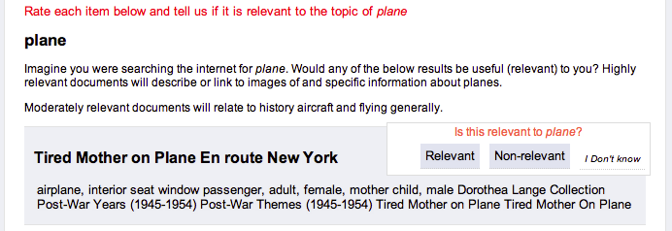
wait, wait This is neat
Since the first rating is confounded with the start of the task, we hypothesized that a latent effect existed.
Hypothesis
That the performance increase is related to users reading the instructions more carefully.
If there is an effect to properly reading instruction, then raters that get the first task correct would be presumably be better overall.
Notes:
Comparing the accuracy of ratings by dwell time, the time spent on the first rating of a set is significantly higher for ratings that are correct than those that are incorrect (Wilcoxon Rank Sum one-sided p=0.01). This stands in contrast to every rating after the first one, none of which show significant difference in time spent on ratings that are true and ones that are false.
Figure 5: Average accuracy of raters' n^{th} overall rating. Note that there is no visible correlation between lifetime experience and performance. Only points representing 20 raters or more are shown.
The fact that a rater who spends more time on the first rating is more likely to be correct suggests that there is a latent effect in how closely people read the description, which is confounded with the time of the first rating. If this is in fact what accounts for the significant different, it should be an effect that lingers across the full set of data. Figure 6 shows this to be the case, with raters that make a correct rating on the first item are much more reliable in the rest of the rating set.

Slide 27
A+
A
B
C
D
Density of percentage of accurate ratings after the first in a set, dependent on whether the first rating was correct. Higher density toward the right side of the graph indicates better performance. When raters started a set incorrectly, their performance skewed much lower for the rest of the set.

Slide 28
Experience
Does rater quality increase with practice?
An extension of the order grouping
Looked at two parts:
lifetime experience
query experience
Notes:
Experience
Does rater quality increase with practice? An extension of the order grouping factor that we looked at alongside dwell time, we considered the long-term experience of a rater. Experience was looked at in two forms: lifetime experience and query experience.
Lifetime experience is the overall number of tasks that a rater has completed. Is a rater's 100th task more likely to be correct than their first task? Our hypothesis was that over time raters would grow more reliable. However, this hypothesis proved to be incorrect.
Figure 5 shows the distribution of accuracy ratings across lifetime experience. Each point represents the percentage of the n^{th} ratings that were correctly rated. If a point at position x shows an accuracy of 0.80, this means that 80% of tasks which were raters' x^{th} rating agreed with the majority, our estimated value for the correct label.
The second measure of experience, query experience, refers to the number of tasks that a rater has completed within a single topical domain. In information retrieval relevance judgments, raters are asked to judge whether a document is relevant to a given query. Similarly, in our secondary dataset of Twitter sentiment ratings, raters were asked to annotate the opinion of the tweet regarding a given topic.
Query experience proved to be an indicator of rater quality among the most experienced users. For approximately the first thirty tasks which raters completed with a single query, they did not demonstrate any meaningful difference in quality. As demonstrated in ­Figure 7, however, ratings beyond that point showed a sharp increase in quality.

Slide 29
Average accuracy of raters' nth rating with a query. Only points representing 20 raters or more are shown. Note that accuracy does not improve among the first thirty tasks that raters complete on a topic, but increases sharply after that.

Slide 30
Agreement
Tried two strategies to account for rater agreement
Removing raters
Raters are assigned a reliability score, and those below a threshold are removed
Weighing raters
Raters are assigned a reliability score which weighs the strength of their contributions up or down.
Notes:
Both of them involved assigned a reliability score to users,
The first...

Slide 31
Replacing Raters
Users are given a Maximum Likelihood user “reliability” score based on the evidence.
Those below a threshold are removed and their ratings replaced by new raters
Threshold was based on the baseline performance, derived by random bot simulation
(i.e. How many labels by User i were correct, divided by their total number of labels, where correctness is determined by majority vote)
Outcomes:
Notable increase in intercoder agreement (Fleiss’s Kappa)
- Very little increase in overall accuracy
Notes:
Problems: It's costly
Good if you need assurances of quality.
Also it goes to show that Kappa scores, while a good indicator for their purpose of measuring contention, are somewhat misused as an indicator of reliability (tell your reviewers that). Not too mention that hundreds of raters require some stretching of Kappa assumption.

Slide 32
Weighing Users and Tasks
We no longer make assumptions of correctness: user scores are now derived by the average probability of a user’s ratings being correct
To separate a user x’s score from the circumstance of their rating (are they rating alongside a good user, bad user?), we use an iterating algorithm
First, the MLE probability of each label is calculated for each rating task R. This is the confidence C.
User scores are set as the average confidence of all their ratings.
Confidence information is updated based on user score. A user’s vote is now weighed Score(U), rather than 1.
Repeat until convergence
Notes:
Rater Agreement and Task Difficulty
In addition to worker experience and time spent per tasks, we looked at the ability of rater agreement and task difficulty to discern the accuracy of ratings. The reason that these were considered together is that they are invariably confounded: a task has as little as three ratings informing any estimates of the quality, and those ratings are each biased by the quality of the specific raters involves.
There were two approaches looked at: identifying and replacing low quality workers, and an iterative algorithm for weighing workers and tasks.
Iterative Optimization Algorithm
While removing raters based on their error rate has a positive effect on the data, it does not take into account the difficulty of the task that is being completed by the rater. If a rater has the misfortune of being assigned a particularly difficult or debatable set of results to rate, their error rate may prove to be quite high. More unfortunate still, a rater may be rating alongside numerous low quality raters. If two low quality raters disagree with one higher quality rater, the dissenting rater's reliability should reflect the circumstances. There may be latent variables that are not accounted by our system which adversely affect the data.
To account for unknown variables and separate out signal from noise, we evaluated a set of iterative algorithms for weighing rater votes and difficulty of the task. In line with the purpose of this study, this approach allows one to not only evaluate raters, but to separate out the effect of the task itself.
Our algorithm iterates over two steps. In the first, an expected vote for each document is calculated, given the information that is available about that document, the possible labels for that document, and the raters evaluating that document. Early on, that information is limited: while it is known how often each option was chosen for each document rating and how often each rater used each option, there is no information about the quality of the ratings or the raters making them.
In the second stage of our algorithm, the assigned labels of the expected votes are used to update the parameters that are used in step one. This involves assigning values of confidence for the results and determining rater quality based on that confidence value. After this stage, the algorithm was iterated again, returning to the first stage for voting on the expected true value.
This algorithm converges or approaches a convergence limit after a number of iterations. The number of iterations that are required before the data converges varies, but only a few are generally needed for relatively simple data such as information retrieval relevance judgments.
The benefit to this approach is that rater quality is less dependent on circumstance. Consider the follow scenarios:
A rater makes a dissenting rating on a difficult task. To form an opinion only on whether they agreed or disagreed with other raters would be unfair to this rater and possibly remove authority from a good rater. For example, in an instance with five raters, there is a difference in whether a rater is the lone dissenter against a majority of four or one of two dissenters against a majority of three. In the latter case, there is a more uncertainty in what the truth value really is. Unfortunately, this scenario is limited for instances with only two-categories and three-raters, such as a large portion of our primary dataset.
A cheating rater is correct by chance. As our earlier simulation found, a random voting rater will be correct 67% of the time in our primary dataset. By weighing this rater's vote according to their overall reliability, their votes, even if correct, will hold less sway. By setting their reliability score based on the confidence in their ratings, their influence will be even lower in subsequent iterations.
For confidence scores Ci∈Ci1, Ci2,…Cil where l is a set of all possible labels – L∈{0,1} for our cultural heritage relevance judgements and L∈{0,1,2,3,4} for our Twitter sentiment ratings – the truth value vote is always chosen as the highest confidence label:
Vi=maxjCi
As the vote can change in subsequent iterations, it is a soft label.
Since voting is always done on the highest confidence label, a number of methods were evaluated for assigning a confidence value to a rating.
For calculating vote confidence, we looked at the following approaches:
Probability of rater agreement for label j of rating task i. This approach represents simple majority voting and was used for comparison. It counts the number of i category labels, |li|, and divides it by the total number of labels received by the task:
Cij=|lij||li|
Due to the lack of rater influence in the expression, this does not require iteration, as it will not change.
Probability of rater agreement for task i given a rater of quality U. This approach, taken before in Sheng (2008), weighs confidence C according to the mean rater reliability scores of the raters choosing each label:
Cij=jUij|lij||li|
A weighted ranking function previously described in (Organisciak 2012). This approach accounts for higher numbers of redundant raters, while also offering diminishing returns on each rater added.
Cij=log⁡(1+lij*kli|li|li+lik*Uik
In addition to task confidence, we considered a number of approaches to weigh rater scores. The basic approach is to use the mean confidence for every single rating that a rater has made before. However, there are two problems with doing so. First, since task confidence is bounded between zero and one, setting raters' scores based on confidence alone will result in continuously declining rater reliability scores between iterations, without any sort of convergence. Such an inequality would also be unevenly distributed, algorithmically punishing raters with more completed tasks. Secondly, since a random rater has an average accuracy of 0.67 in our dataset, the range between good and bad raters is small and skewed upward, making it ineffective for weighing votes. Ideally, on a task where two theoretical cheaters disagree with a near-perfect rater, an early iteration should flip the vote in favor of the better voter.
Rater quality was weighed in the following ways:
Exponential decay. Reliability scores are calculated by the mean confidence of a rater's tasks and then raised exponential, to the power of two or three, depending on how aggressively the algorithm's confidence weighting is. A decay function can disrupt an algorithm's convergence and requires lower boundaries.
Reliability score normalization. The mean of all reliability scores is normalized to a value of 1.0. This weighting is calculated as the sum of all reliability scores divided by the number of raters:
Ui=Ui1|U|jUj
Relative scoring. Reliability scores are calculated on the confidence of their ratings relative to the highest rating in each set.
For comparison, we also ran a rater reliability scoring function as described in Wang et al. (2011), which is based on the accuracy rate of the raters (i.e., how many they rated correctly compared to incorrectly) without any weight given to the confidence in the tasks that they completed.
The various techniques for calculating confidence and setting rater reliability scores were combined in sensible ways and evaluated. Accuracy rates were recorded for the number of correct labels applied at the fifth iteration of each algorithm.
Robustness was also tested, by emulating malicious raters. Bots replaced random raters' ratings with their own undiscerning ratings. The false ratings consisted of 5% of the data and were used to see whether there were differences in how the algorithms handled clear cheaters.
The algorithm combinations were as follows:
Majority: The baseline vote based on majority labels.
Basic Algorithm: Described in Wang et al (2011). Confidence is weighed by rater reliability, and rater reliability is dependent on basic accuracy rate.
Basic with Reliability Decay: Modification of basic algorithm, with exponential rater reliability score decay.
Regular with Reliability Decay / Normalized / Relative Scoring: Confidence is weighed by rater reliability, and rater reliability is weighed in one of the ways introduced above.
Alternate Algorithm: Confidence is calculated using the approach previously described in Organisciak (2012).
Table 1 displays the accuracy ratings for the various runs. This can inform a number of observations.
Once again majority voting appears to be quite effective. Consider the baseline majority accuracy of 0.8573 in comparison to the similar task of relevance judgment in the TREC Crowdsourcing Track, where the best algorithms peaked at 0.70 accuracy of the gold label set, and it becomes clear that our dataset is fairly clean from the start (Lease and Kazai 2011). The effectiveness of the baseline majority vote for the primary data is also accentuated by the relatively small gains in accuracy that is gained by the algorithm combinations.
In contrast, the Twitter sentiment dataset has a much lower baseline. The bandwidth of contribution with this data is considerably more spread out — where with the binary categories the worst case scenario for three raters is agreement between only two, the five-category Twitter data can result in nobody agreeing. With the Twitter data, raters also showed an aversion to administrative categories: when the oracle rater would rate a message as “spam” or “incoherent”, the online raters avoided doing so. In our IMLS DCC data, this rater coyness was seen with the “I don’t know” ratings, but those were treated as missing data and removed.
For its lower starting point accuracy, the Twitter data showed greater improvements in accuracy with the iterative algorithms than the relevance ratings. Similarly the iterative algorithms proved more robust against the cheaters that were artificially inserted into the data. This seems to point to their usefulness with particularly problematic data.
The iterative algorithms did not have the same effects, however. Notably, the basic algorithm with an exponential decay performed better than expected. This algorithm weighs voting according to rater reliability scores, but rather than weighing rater reliability by the confidence in the rating that the rater makes, it simply uses the rater’s accuracy rate. By applying an exponential decay to the rater reliability scores, it gives the generally conservative algorithm more power to pull down low quality raters. Still, one possibility for this surprising result is that it is not as aggressive in separating out raters as the other versions. A future direction worth exploring would be a deeper look into the individual votes that flip or do not flip with these algorithms, and how often good votes are accidentally overturned.
Investigating an iterative algorithm for optimizing rater quality and task difficulty, we found that it held limited usefulness for three-annotator two-category annotation. This is likely due to the limited amount of variance allowed by the structure. There are only two states of majority opinion –three-rater consensus or a two agree/one disagree– meaning that when a rater disagrees there is little information on whether it is because they are a bad rater or because it is inherently a difficulty to agree-upon tasks. More information can become available by including more categories or increasing the number of raters. However, including more raters also has a positive effect on quality. Thus, the experience of this study is that for binary labels, majority rating is generally robust enough.

Slide 33
Weighing Users and Tasks
Determining Correct Vote
Majority rating
Majority rating weighted by user scores
Alternative approach (Organisciak 2012)
Confidence scoring task
Accuracy rate
Sum of rating confidence
Smoothing scoring user
Normalize user scores to 1
Exponential decay
Relative rating – Score users relative to highest user score
Notes:
Exponential decay – worse users are punished more
Relative

Slide 34
Distribution of rater reliability scores based on accuracy rate, shown in descending order.

Slide 35
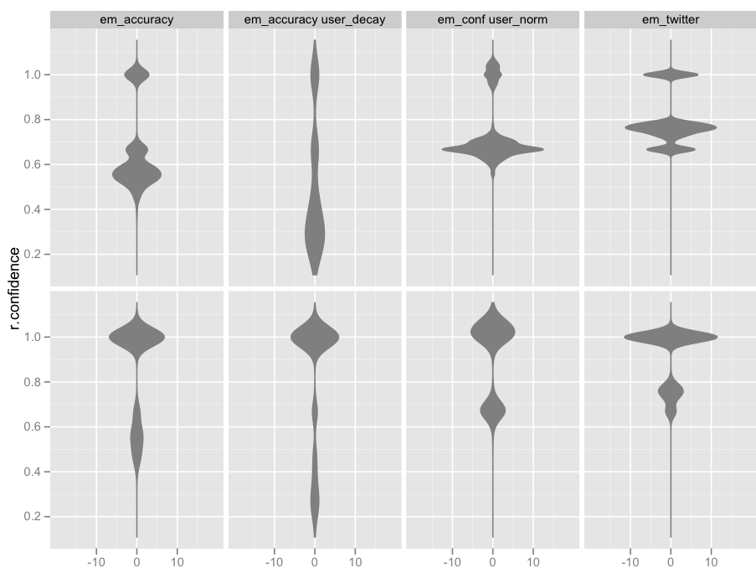
the Results
The lower bound was quite high
Voting by majority was very robust for IMLS DCC relevance judgments, less reliable for tore complex Twitter data
Iterative algorithm offered insignificant improvement over simple majority voting for DCC data
Basic w/
Decay
Regular
w/Norm
Basic
Alternate
Density of
False Ratings
Best results were with exponential smoothing, but it violates monotonicity
Density of
True Ratings
Confidence Density of True/False
Notes:
The lower bound was quite high (previously mention 0.67)
Voting by majority was very robust for IMLS DCC relevance judgments, less reliable for tore complex Twitter data
Iterative algorithm offered insignificant improvement over simple majority voting for DCC data

Slide 36
What Have We Learned about online raters?
For clean data, majority voting among multiple raters is enough.
Compare our nearly 86% accuracy for a baseline with the best algorithms in the TREC Crowdsourcing Track at ~70% (Lease and Kazai 2011)
Mechanical Turk raters are generally honest
Raters that get the first rating of a task correct are better raters overall. This may be due to avoidable sloppiness.
Raters grow comfortable with a task quickly, and their quality does not significantly increase with more experience
EM-like algorithms remove more problem raters with complex tasks. The improvement for relevance judgments is small.
Notes:
For clean data, majority voting among multiple raters is enough
The IMLS Data had 86% accuracy for
Online raters are generally honest
Mechanical Turk raters are generally honest:
Raters that get the first rating of a task correct are better raters overall.
What part of this is misunderstanding?
-- We believe that at least part of this is recoverable by have raters read the task close. Thus, rather than treating them as bad raters post-task, we expect that you can see improvement through the use of Mechanical Turk “Qualifications” to incentivize them to play close attention to the task description (the codebook)

Slide 37
IMLS DCC
Digital Collections and Content
Grant: LG-06-07-0020
CIRSS
Center For Informatics Research In Science And Scholarship
GSLIS
Graduate School Of Library And Information Science
PETER ORGANISCIAK, MILES EFRON, KATRINA FENLON, MEGAN SENSENEY
Contact
organis2@illinois.edu
Other Contributing Members
Timothy W. Cole, Thomas Habing, Jacob Jett, Carole L. Palmer, And Sarah L. Shreeves.

Slide 38
TASK

Slide 40
People like to interpret
Better contributions come from people that spend more time reading instructions
Notes:
One of the tenants of classification research in library science is the importance of codebooks for achieving inter-coder reliability. However, online people are used to short, succinct interactions, and they often don’t read the instruction set.
Alt Hypothesis: Spending more time on a tasks indicates better performance (Wilcoxon Rank Sum p < 0.001, with Bonferroni adjustment),

Slide 41
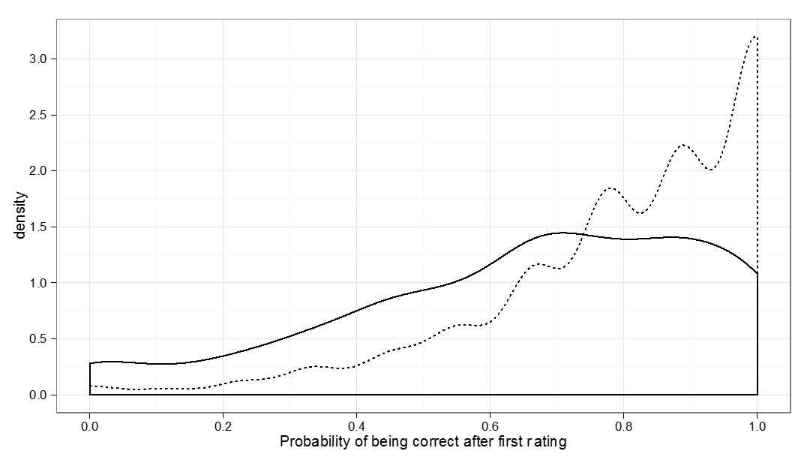
Notes:
One of the tenants of classification research in library science is the importance of codebooks for achieving inter-coder reliability. However, online people are used to short, succinct interactions, and they often don’t read the instruction set.

Slide 42
How do you control for different interpretations of a task?
Scaling up difficulty
Normalizing for user-specific biases
Training, testing
Feedback
Anchoring

Slide 45
Broad Research Question #1
Broad Research Question #2
Broad Research Question #3



What are the post-collection indicators of quality in worker-contributed objective task data, and can these be leveraged for improved data modelling?
What are the biases inherent to the task design for objective or normative tasks (i.e. the data collection instrument), and can design manipulations correct for them at collection time?
What are the quality losses when treating non-normative tasks in objective ways, and can collection-time framing or post-collection modeling approaches reduce these?
45

Slide 60

❑
Not all crowdsourcing uses have a common goal or objective. There are many needs that differ from person to person.

Slide 61
Broad Research Question #1
Broad Research Question #2
Broad Research Question #3



What are the post-collection indicators of quality in worker-contributed objective task data, and can these be leveraged for improved data modelling?
What are the biases inherent to the task design for objective or normative tasks (i.e. the data collection instrument), and can design manipulations correct for them at collection time?
What are the quality losses when treating non-normative tasks in objective ways, and can collection-time framing or post-collection modeling approaches reduce these?
61

Slide 62
Good for…
Personal collections
New corpora
Niche information
Time-dependent preferences
Notes:
Why would you want on-demand personalization?
Good for collections with little existing data
Personal collections
E.g. personal photos, email
New corpora of data
E.g. the next Amazon, Netflix
Niche information
Where nobody would care enough to collect such preference data, nor would people care to volunteer it
Time-dependent opinions
When things change (e.g. food cravings, film desires), it’s difficult to collect information over an extended period of time

Slide 63
SECTION ONE
Creative Visual Design


Personal collections
E.g. personal photos, email


New corpora

E.g. the next Amazon, Netflix
Items 02

Niche information
Items 03

Where nobody would care enough to collect such preference data, nor would people care to volunteer it
Items 04
Items 05

Time-dependent preferences
When things change (e.g. food cravings, film desires), it’s difficult to collect information over an extended period of time
63
Notes:
Why would you want on-demand personalization?
Good for collections with little existing data
Personal collections
E.g. personal photos, email
New corpora of data
E.g. the next Amazon, Netflix
Niche information
Where nobody would care enough to collect such preference data, nor would people care to volunteer it
Time-dependent opinions
When things change (e.g. food cravings, film desires), it’s difficult to collect information over an extended period of time

Slide 64
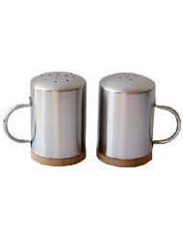
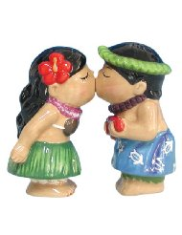

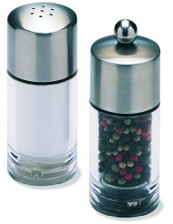
Notes:
I have a question.
Say you’re looking for a new set of salt and pepper shakers for your home Do you….
<click>… go for the charming kitsch of the kissing figures?
<click>Choose sleek option B?
<click>Perhaps you prefer the gift shop novelty of C or <click>the hominess of D?
(Ask audience for opinion)

Slide 65
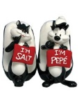



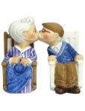
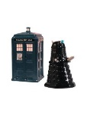
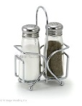

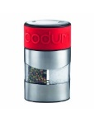
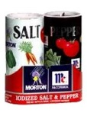

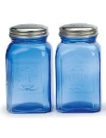

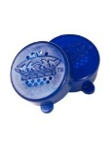
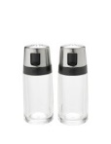

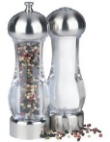
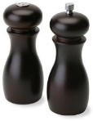
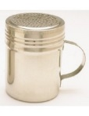


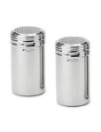
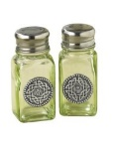




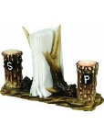
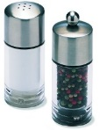

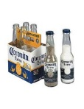
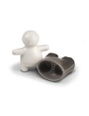
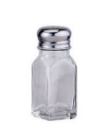
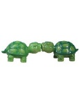
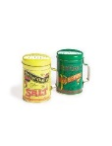
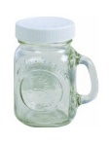

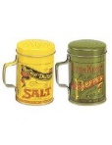
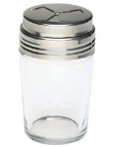



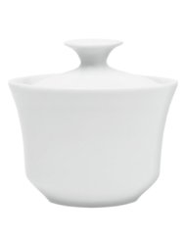
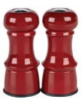
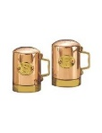
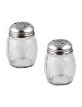
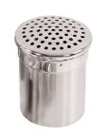
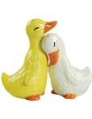
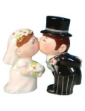
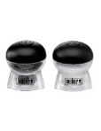
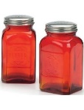
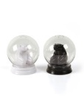
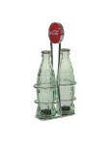


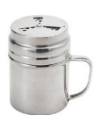
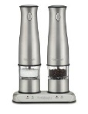
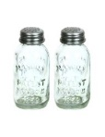


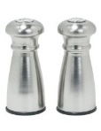


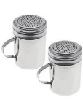

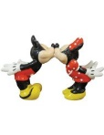
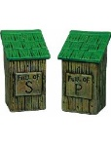

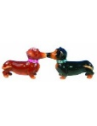
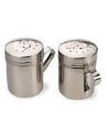




















Notes:
Okay, realistically we know that the space of salt and pepper shakers is much large than four.
that perfect item may be out there, but it doesn’t seem like something worth sinking too much of your time into.
Today we tackle this problem, of things you may not want to do, but that depend on your opinion that you have.
We do so, of course, through crowdsourcing.

Slide 66
















































































Notes:
In a case like this salt shaker example, you can use crowds to reduce your space considerably.
If you like the kissing Hawaiian, there’s many more similarly cute product (including a whole subgenre of kissing dogs)
If you like the gnome, there only two others for you, neither of which should be would be appropriate in this forum…

Slide 67













Notes:
How about other cases, like finding the food you’re craving ….

Slide 68

Notes:
Or filtering out the best photos from your vacation?

Slide 69
†
‡
We show that crowdsourcing is useful for personalization
† Spoiler alert
‡ with nuances – this is where we help!
Notes:
…
3. We show that crowdsourcing can be useful for personalization.
First of all:
<click>
Sorry for giving away the ending, but also, the fun lies….
<click>
… in the nuances.
We evaluate numerous contexts over various data
Giving us an impressive of what is appropriate, when

Slide 70
Taste-matching
Requester
$$sim(requester, worker)$$
Crowd Worker
Notes:
How do our approaches work? In the first…
Taste-matching
Things to note
Finding your taste-soul mate; building your turker army
Similar to on-demand collaborative filtering
You can borrow techniques from there, e.g. sim measures
Where it can change
Similarity metric
Choice of training items
Size of training set
Not worth mentioning in talk: (Recommendation method: do you take a single similar worker’s suggestion, or an aggregate)

Slide 71
Taste-Grokking
Requester
Requester
Crowd Worker
Notes:
Taste-Grokking
Things to note:
No similarity measure
Showing by doing
Similar approach, but communicating by explanation, is utilized for travel-planning with Mobi (Zhang et al.) and

Slide 72




Requester
Requester
Requester
Requester
Notes:
Since multiple grokkers are thinking of the same person, grokking lends itself easily to aggregation

Slide 73

Notes:
Like the proverbial blind men beholding an elephant, each grokker has their own interpretation of the truth that is more effective in the bigger picture.
(No known copyright, http://www.loc.gov/pictures/item/2004666374/)

Slide 74














Task 1: Image Recommendation
Products
?
?
?
?
Food
?
?
?
?
Notes:
We applied these two protocols, taste-matching and taste-grokking, to two different types of tasks
Size of set used for profiling: 10 items; size of recommendation set:90
Image Recommendation
Product recommendation
Specifically, saltshakers
A highly visual decision, not common to find people rating multiple saltshakers in existing data
Food
Photo and name given
Two datasets provided, via Foodspotting: Seattle and Boston.
Quality of photo controlled for, somewhat, by sampling only most popular photos.
These are photos of food that are already liked, we want to differentiate by people

Slide 75
Results
Taste-Matching
Measured using root-mean-squared-error, to measure deviation of recommendation from ground truth of requester preferences
 | Products | Food Set #1 | Food Set #2
Baseline | 1.64 | 1.51 | 1.58
Best matched of five-workers | 1.43 (13%) | 1.19 (22%) | 1.26 (20%)
Best matched of ten workers | 1.35 (18%) | 1.08 (29%) | 1.08 (31%)
Notes:
The quality of the workers you find depends on how man you ask.
If you take the word of 1 person (the baseline)…
If you match against five people and use the opinion of the best…
Match against 10 people…
I’ll discuss this further later, but note that
Improvements on both sides, but
<click>
Food data was better improved by matching than product data
(why not aggregate taste-matching? This is possible; we were thinking of cases where you can accumulate ‘assistants’ that would look at different parts of the dataset for you)

Slide 76
Results
Taste-Grokking
 | Products | Food Set #1 | Food Set #2
Baseline | 1.64 | 1.51 | 1.58
Any grokker | 1.29 (21%) | 1.53 (1.3%) | 1.57 (0.5%)
5 rand grokkers | 1.07 (34%) | 1.38(9%) | 1.28 (19%)
5 good grokkers | 1.02 (34%) | 1.22 (19%) | 1.13 (28%)
Notes:
We found the inverse to be true for taste-grokking.
For taste-grokking, the salt-shakers are predicted much better.
For the food, if you ask anybody to guess, they’re not going to be that good; asking a few peope improves that recommendation.

Slide 77


Results
Personalization in this form was a good fit for crowdsourcing
Matching was better for food, grokking better for salt-shakers
Latent vs. Manifest decision factors: overfitting mental models
Increases in N are more fruitful for matching
Notes:
Matching was better for food, grokking better for salt-shakers
Why?
The factors of saltshaker decision making is more visible
When we tried clustering by taste, we saw more surprised in how food groups: overfitting mental models
In a complex space like food, you may need more profiling examples
If you can afford it, added people to matching keeps improving quality
In grokking, you only need a few people

Slide 78
Super-grokkers
The best grokkers outperform the best-matched
 | Products | Food | Food
Baseline | 1.64 | 1.51 | 1.58
Taste-matching: Best 3 workers | 0.89 (46%) | 1.02 (32%) | 1.19 (25%)
Taste-grokking: Best 3 workers | 0.87 (47%) | 0.78 (48%) | 0.79 (50%)
Notes:
- The trick is identifying them beforehand, which is difficult to do

Slide 79
























Requester
Requester
Crowd Worker
Notes:
In all these experiments, we randomized the training examples, but it should be noted that the training data matters.
When we purposively chose profiling information to maximize breadth…

Slide 80

Notes:
We saw a clear improvement in grokking ability.

Slide 81

Task 2: Text Summarization
Film Reviews
Notes:
Recommendation is a fairly straightforward task. Can we personalize on much more complex tasks?
To this end, we looked at the ability of crowd workers to highlight film reviews for summarization. They would try to mimic both the salient content, and the amount of highlighted.
- difficult to measure, we used text overlap via F1 measure (the harmonic mean btw precision and recall)
Training example N=1 (based on expected information communicated)

Slide 82
Matching does work for a complex task like this
Grokkers fare poorly, but once again, we see super-grokkers
Potentially an appropriate task for written expression of needs, a la EmailValet (Kokkalis et al. 2013) and Mobi (Zhang et al 2012)
 |  | Performance ($F_{1}$)
Baseline |  | 0.32
Taste-matching | Best-matched workers | 0.39 (20%)
 | 5 best-matched workers | 0.38 (17%)
Taste-grokking | Any worker | 0.30 (7%)
 | Best workers (pool of 5) | 0.52 (62%)
Notes:
Film highlighting
Surprisingly, matching does work for a complex task like this

Slide 83
Matching or Grokking
Data Re-use
Grokking is requester-specific; matching is useful for bootstrapping collaborative filtering and has higher ceiling.
Quality Control
Grokking is task-driven, with apparent ground truth – traditional quality control can be used.
Task Complexity
Are the factors affecting opinion-forming easy to communicate by example?
Satisfaction
Feedback suggests grokking seems more fun
Notes:
Grokking is task-driven, with apparent ground truth – traditional quality control can be used.
In matching, workers are asked to give their opinion, so it’s hard to tell if they are cheating; however, they’ll usually remain unmatched
Task complexity
Are the factors affecting opinion-forming easy to make sense of?
- Our workers spoke of their decision making for salt-shakers in predominantly visual terms

Slide 84
Takeaway
Crowdsourcing doesn’t have to be only objective or normative tasks! It is promising in domains where lack of prior data limits established personalization methods.
Taste-matching is good for personalizing complex tasks, and ongoing engagements with workers
Taste-grokking is great for quick-start tasks with manifest opinion factors, and for spicing up boring tasks

